Slide 1
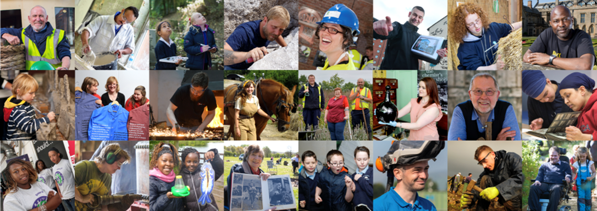
Rural skills training to sustain
rural communities
Emma Stagg,
Policy Adviser, Skills
emma.stagg@hlf.org.uk
@EmmaStagg
#SkillsfortheFuture

Slide 2
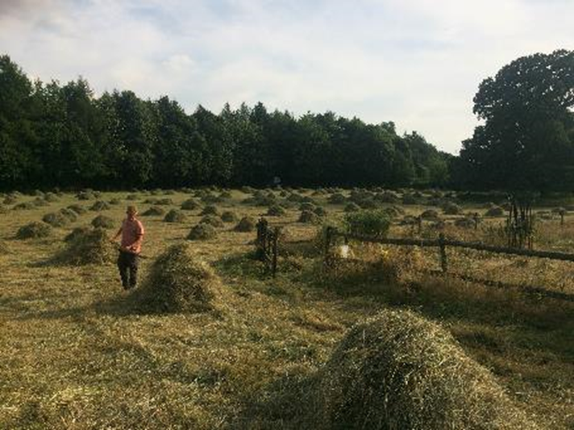
Overview
Why?
What?
How?

Slide 3
HLF and Skills
More than ever in these difficult times, HLF wants to focus on offering people skills that will give them a future career and at the same time meet the needs of the sector. I believe passionately that heritage can play a significant part in economic recovery.”
Dame Jenny Abramsky, former Chair
July 2009
Notes:
By end of Cohort 3 projects – over 10 years+ of investment in skills and traineeships across the heritage sector
Investment in skills across our grants programme, plus Skills for the Future
Investment in projects large and small across the UK
Knowledge base of experience and evaluation

Slide 4
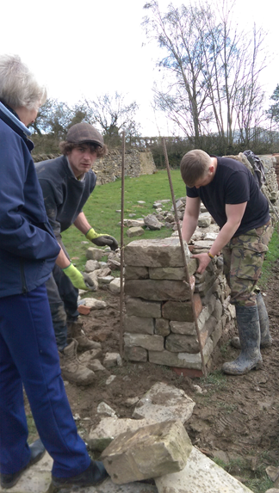
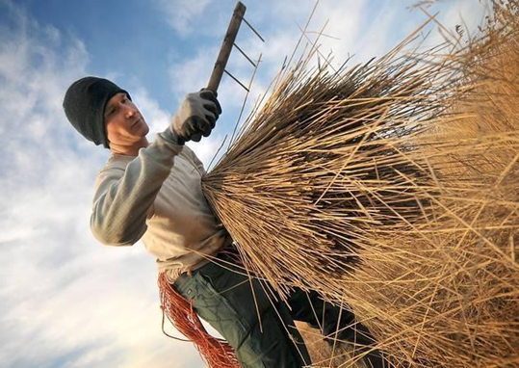
Rural skills training…
Some examples:
Reed cutting
Millwrighting
Path making
Dry stone walling
Hedge laying
Coppicing

Slide 5
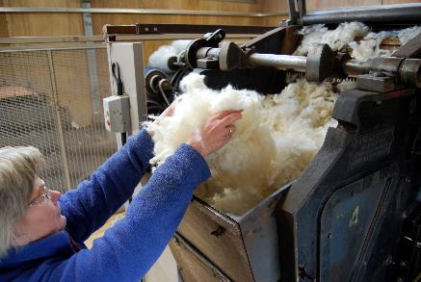
…to sustain rural communities
Transferable skills
Supporting enterprise
Self-employment
Resources and equipment
Creating jobs where people live
Networks and partnerships

Slide 6
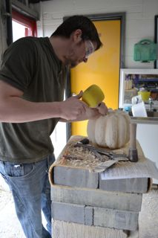
Challenges
Awareness of heritage skills or careers
Local training providers
Local recruitment
Transport and accessibility
Career progression

Slide 7
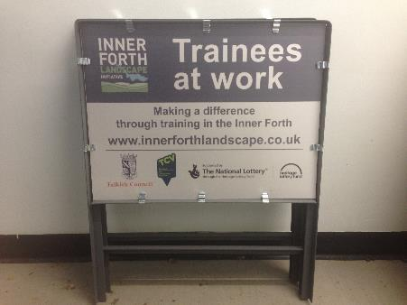
And opportunities
Apprenticeships
Traineeships
Work experience
T-Level qualifications

Slide 8
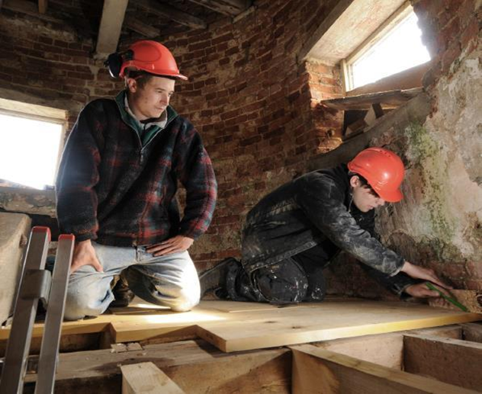
Water, Mills & Marshes, The Broads
Authority
Careers in heritage construction
Introduction to Heritage Skills in Construction (Level 2), City College Norwich
400 students
https://youtu.be/VMla31J17mA

Slide 9
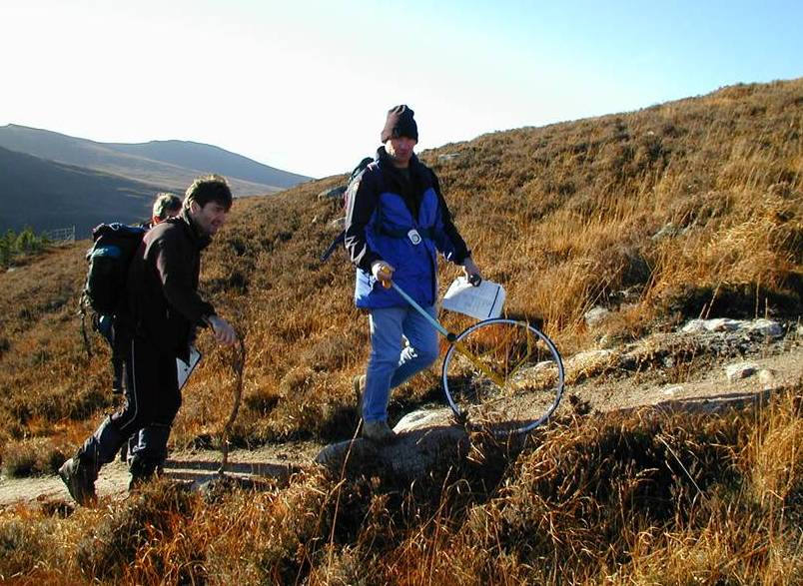
The Mountains and the People
Outdoor Access Trust for Scotland
Upland Path Worker training
6-month paid training opportunities
Progression into employment
https://vimeo.com/268583782

Slide 10
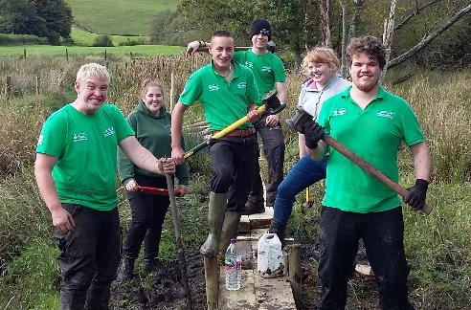
Rusland Horizons
Lake District National Park Authority
Valley Futures Apprentices
Level 2 & 3 Environmental Conservation
18 months
Askham Bryan College
https://youtu.be/aNuca4SnyU4

Slide 11
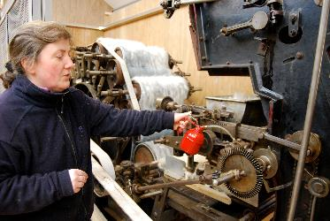
Transforming Textile Traditions
Uist Wool
Wool working traditions in the Outer Hebrides
New heritage skills for local people through paid traineeships
Supporting a viable community enterprise

Slide 12
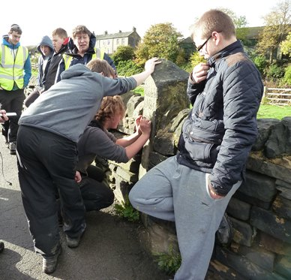
Beyond Graffiti
The Milestone Society
100 young people introduced to stone and carving in the local landscape
Partnership with college, council, Master Waller, sculptors, local quarry
https://youtu.be/0JwREVwVmRU

Slide 13
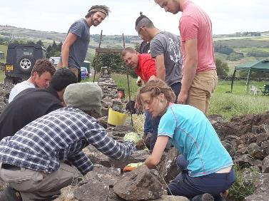
National Training Bursary Project
Dry Stone Walling Association
Increasing diversity within the dry stone walling sector
12 month placements with further 6 month support into employment

Slide 14
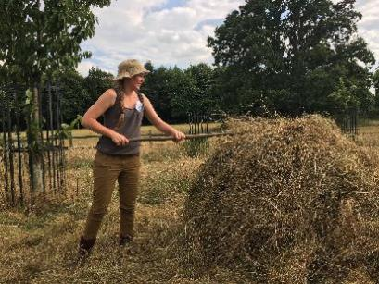
Handing on the Heritage Baton
Chiltern Open Air Museum
Museum setting
Traditional farm heritage skills
Rural Heritage traineeship

Slide 15
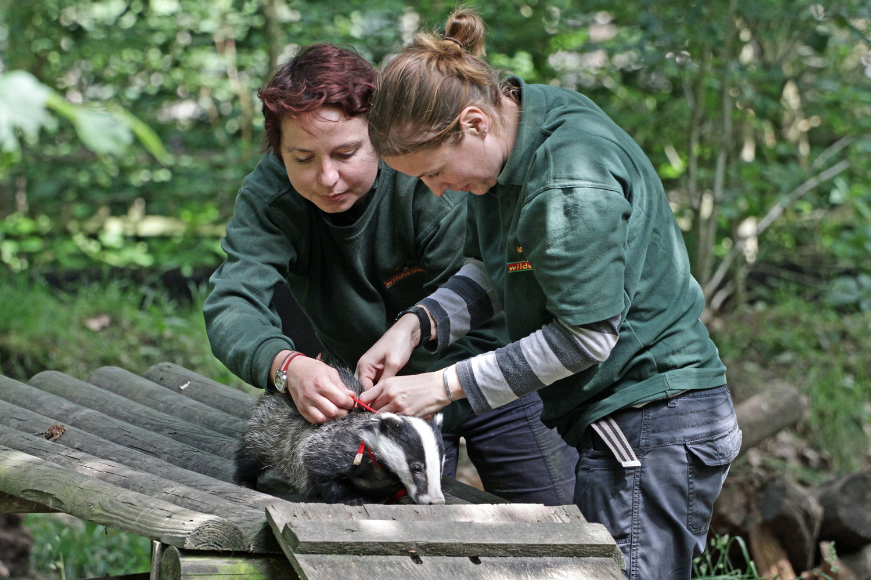
Moving Forward
Sharing learning more effectively
Supporting and resourcing training and apprenticeships
Training led and delivered by a range of partners
Ensure the offer is inclusive

